Slide 1
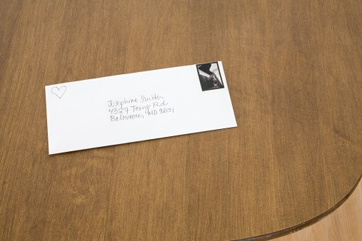
ADDRESS

Slide 2
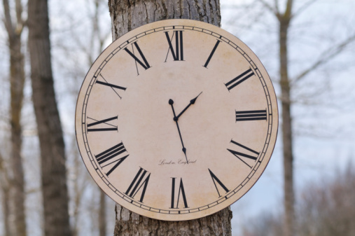
AFTERNOON

Slide 3

AMERICA

Slide 4
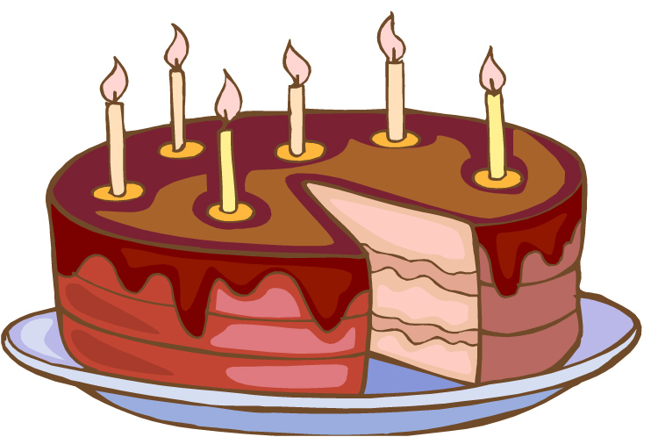
BIRTHDAY

Slide 5
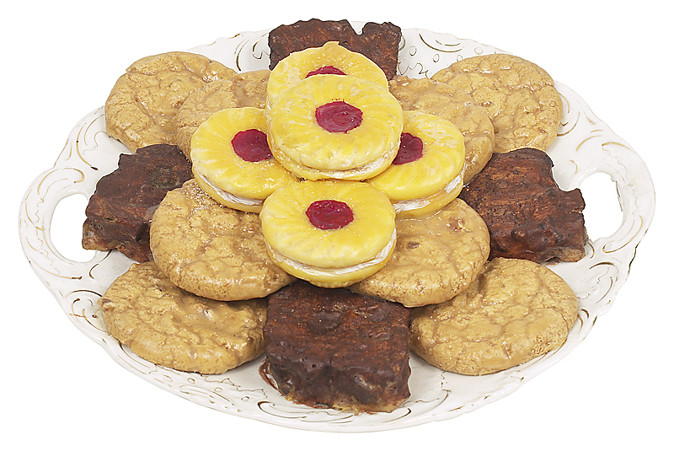
BISCUIT

Slide 6

BRITAIN

Slide 7
BROWN

Slide 8
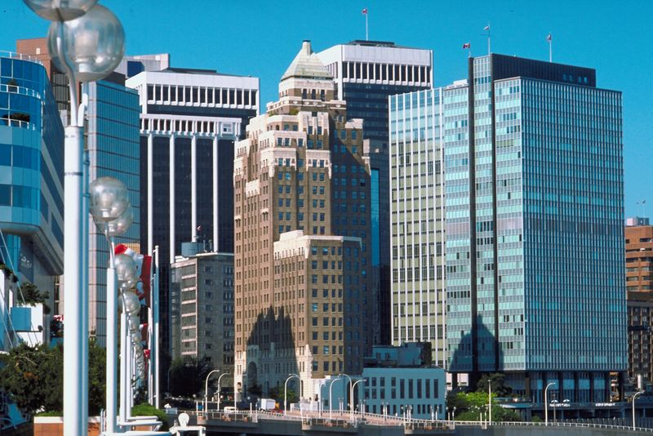
BUSINESS

Slide 9

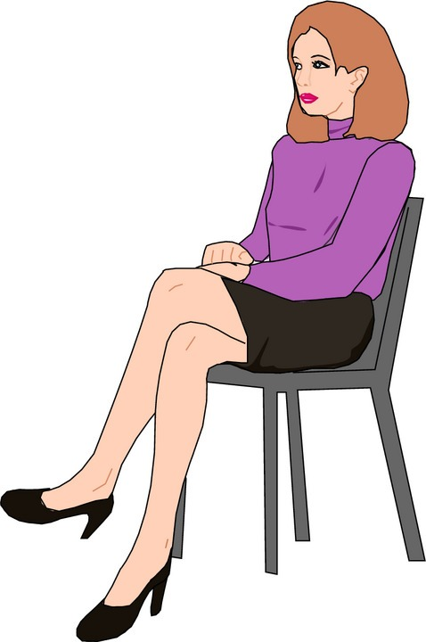
CHAIR/SIT

Slide 10

CHINA

Slide 11
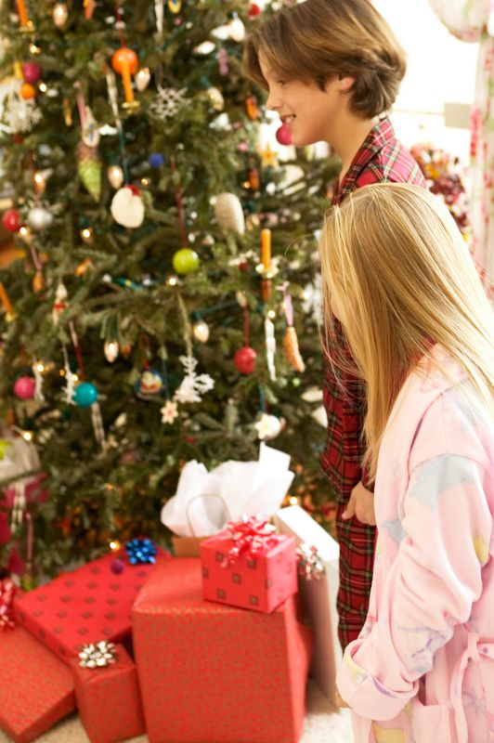
CHRISTMAS

Slide 12

COLOUR

Slide 13

COMPUTER

Slide 14
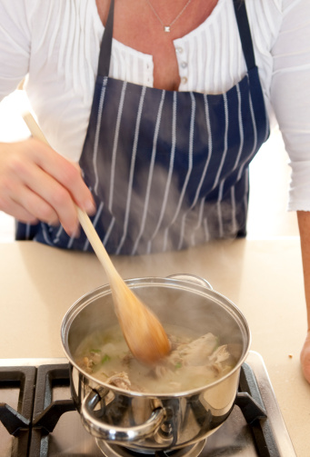
COOK

Slide 15

DEAD

Slide 16
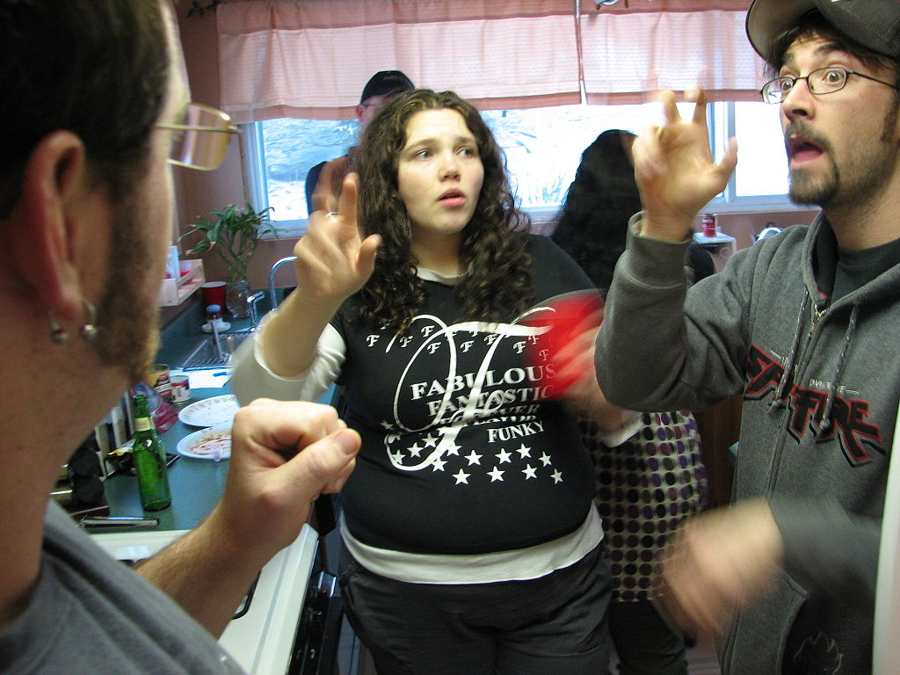
DEAF

Slide 17

DOCTOR

Slide 18

FAMILY

Slide 19
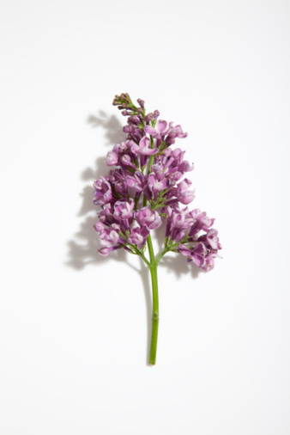
FLOWER

Slide 20
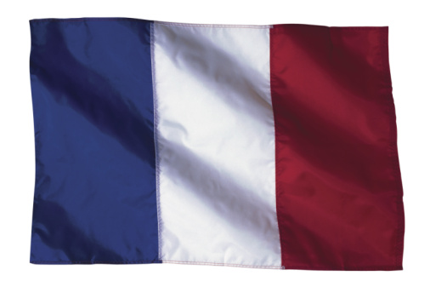
FRANCE

Slide 21
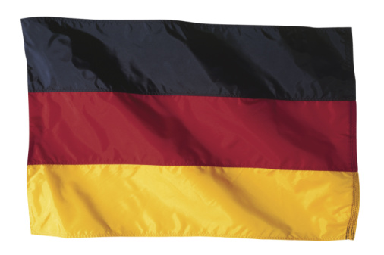
GERMANY

Slide 22
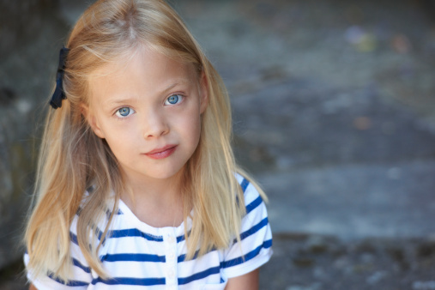
GIRL

Slide 23
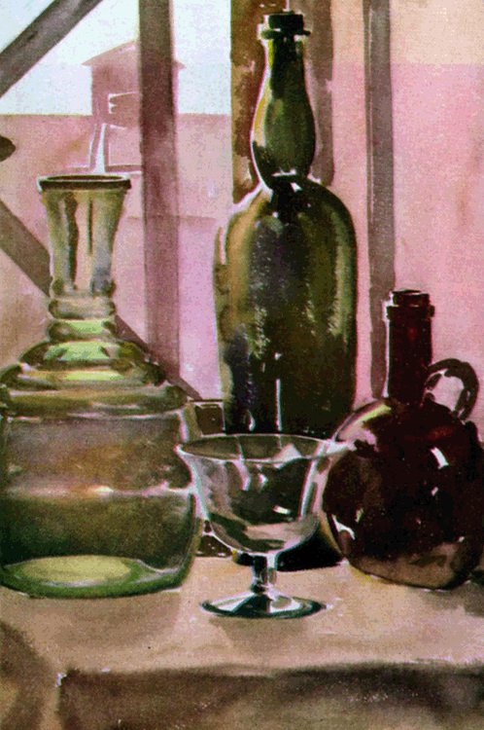
GLASS

Slide 24
GREEN

Slide 25
GREY

Slide 26

HEARING

Slide 27
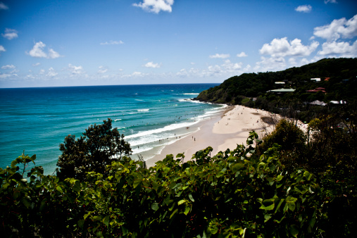
HOLIDAY

Slide 28
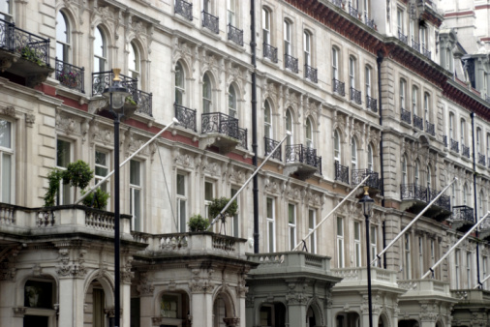
HOME

Slide 29

HOSPITAL

Slide 30
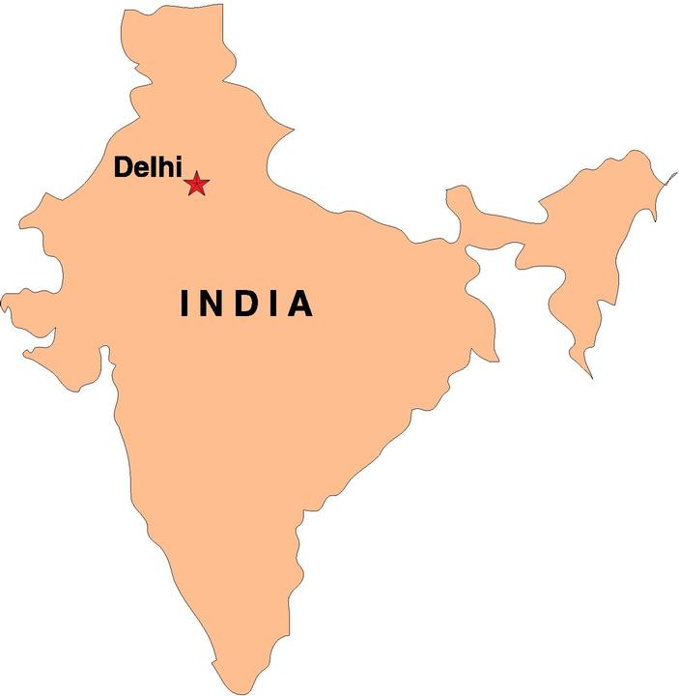
INDIA

Slide 31

INSURANCE

Slide 32
INTERPRETER

Slide 33

IRELAND

Slide 34

ITALY

Slide 35
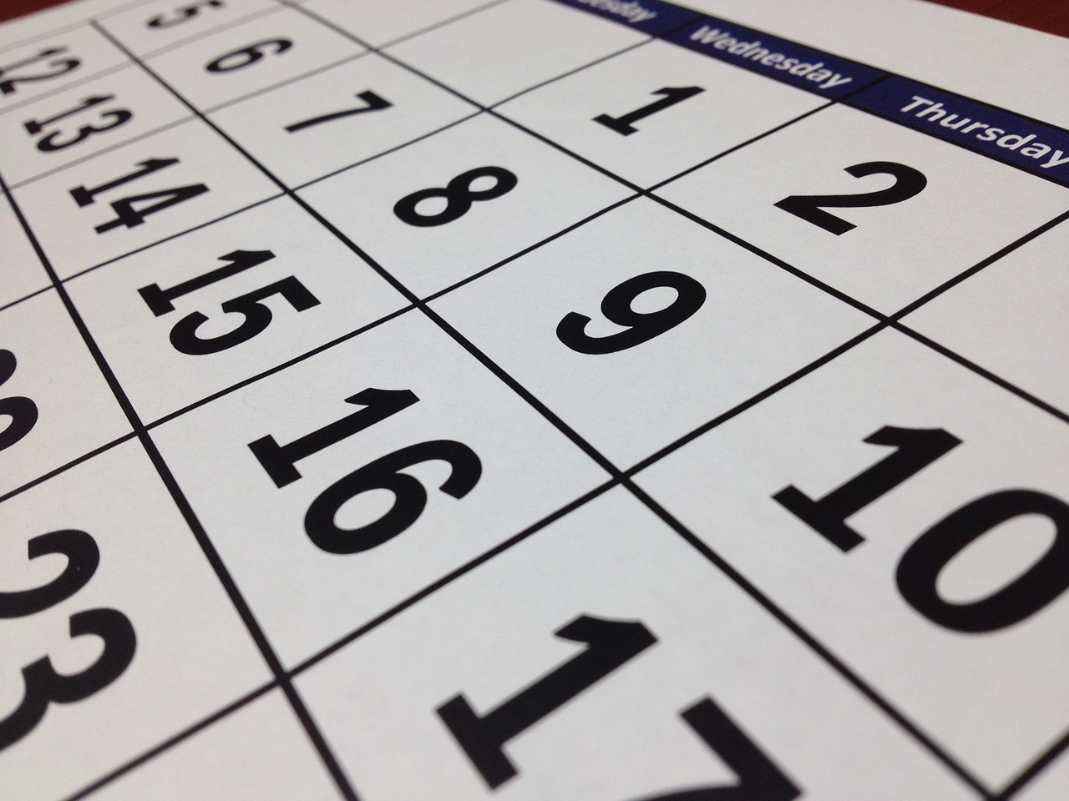
NEXT WEEK

Slide 36

LEAF

Slide 37
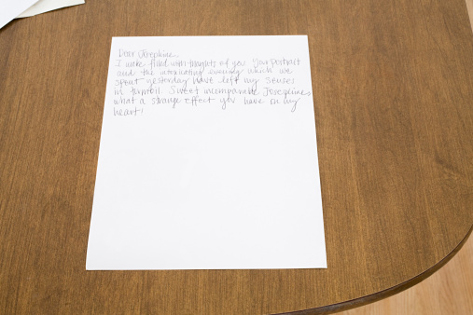
LETTER

Slide 38

MAN

Slide 39
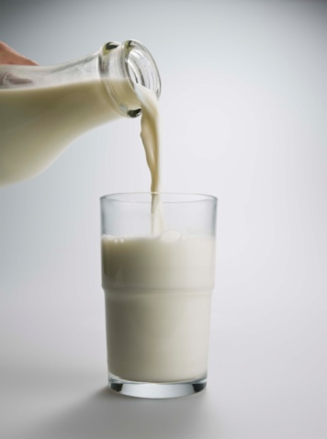
MILK

Slide 40

MORNING

Slide 41
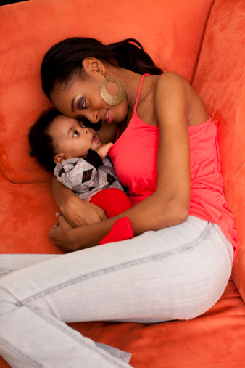
MOTHER

Slide 42
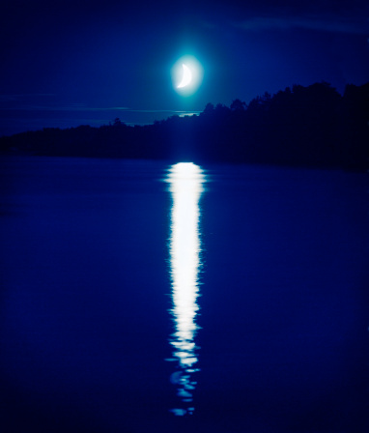
NIGHT

Slide 43

NURSE

Slide 44
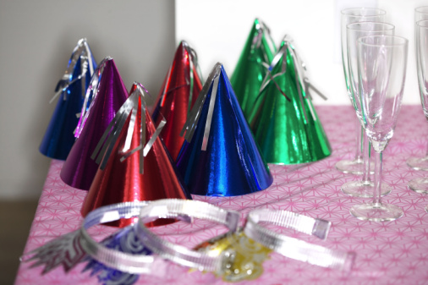
PARTY

Slide 45
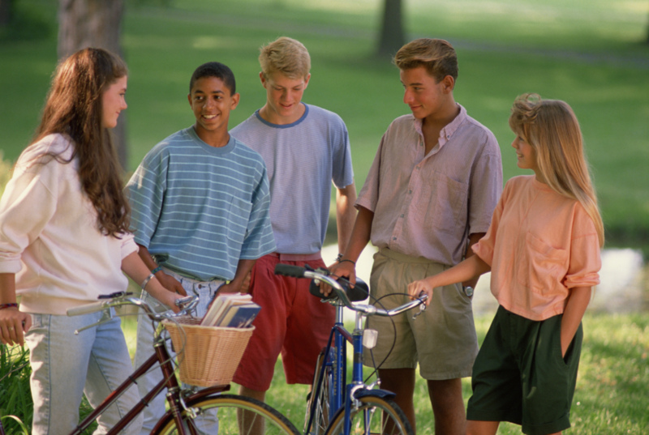
PEOPLE

Slide 46
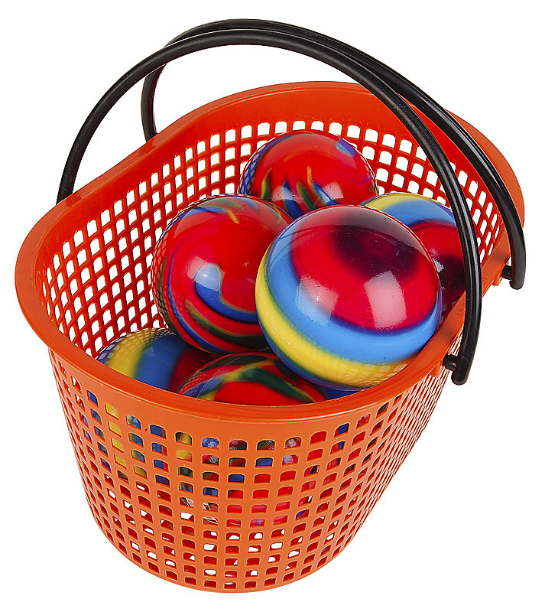
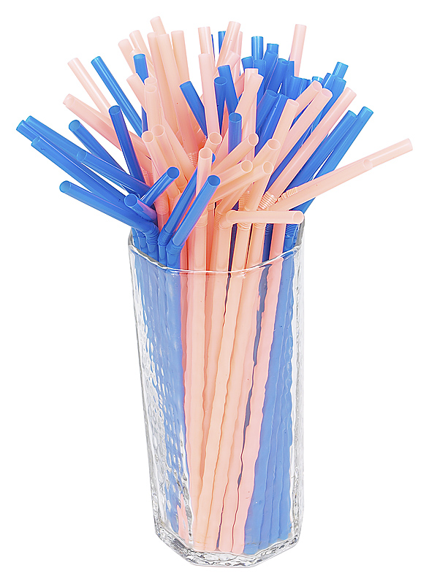
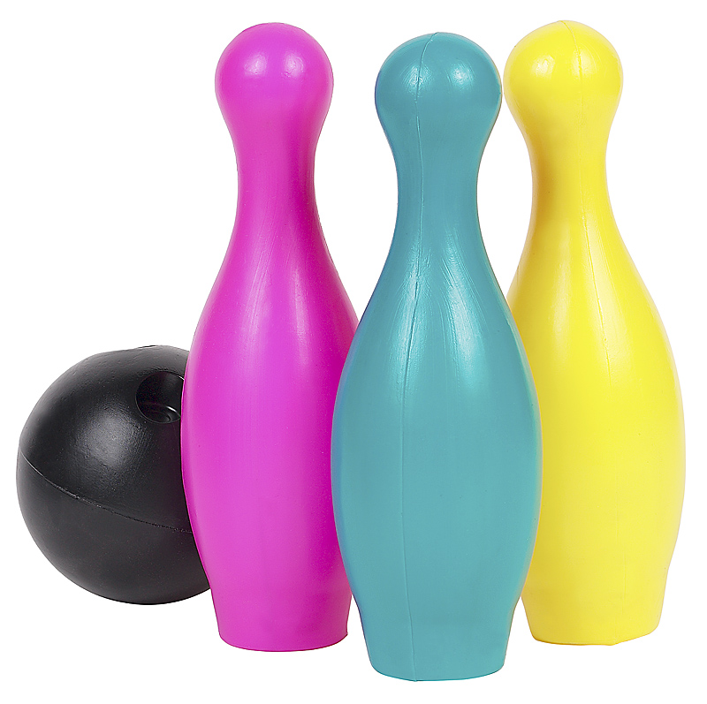
PLASTIC

Slide 47

POISON

Slide 48
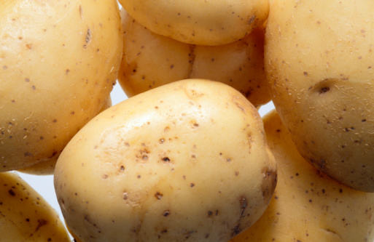
POTATO

Slide 49
PURPLE

Slide 50

SCHOOL

Slide 51
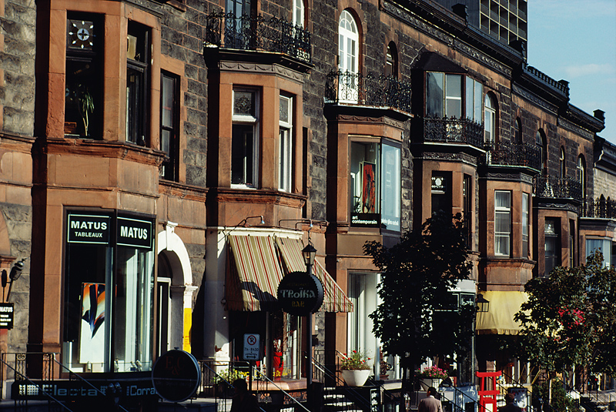
SHOP

Slide 52
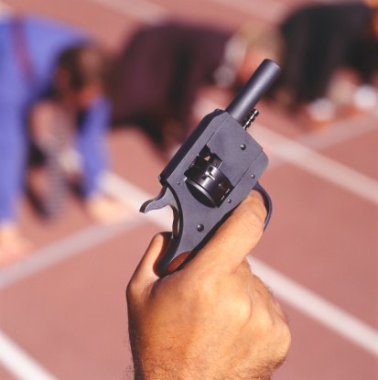
START

Slide 53
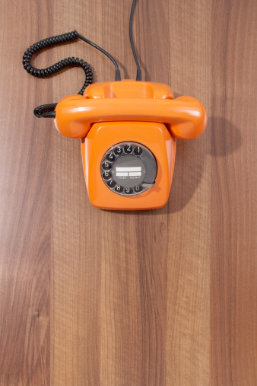
TELPHONE

Slide 54
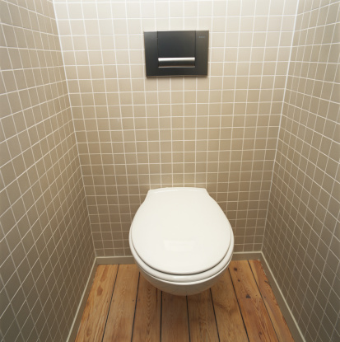
TOILET

Slide 55
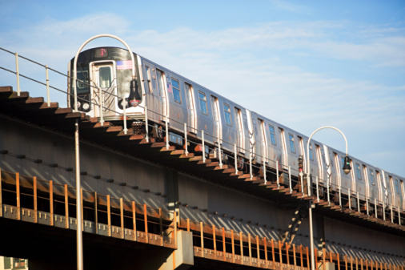
TRAIN

Slide 56
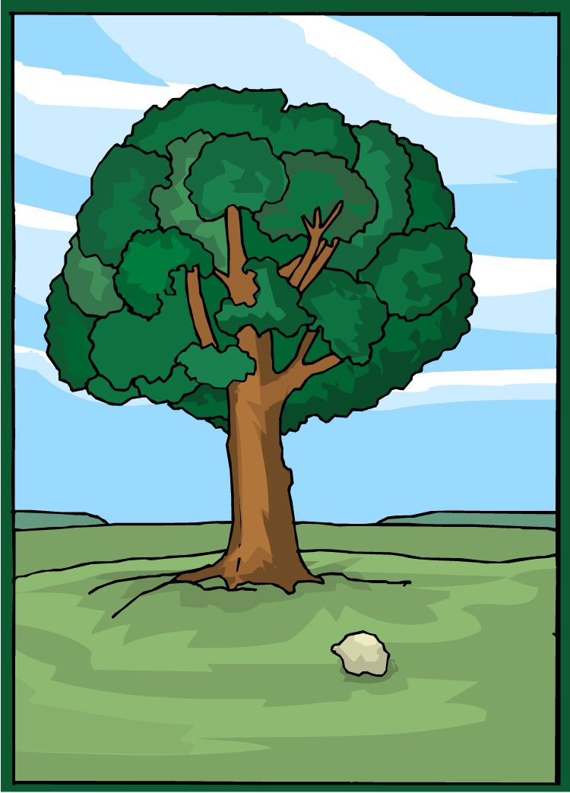
TREE

Slide 57
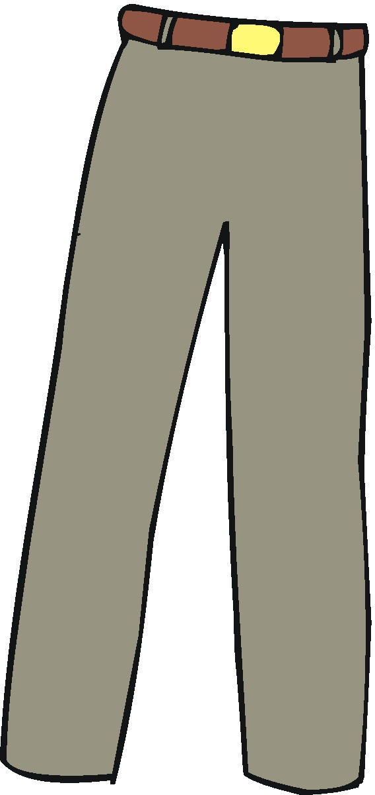
TROUSERS

Slide 58
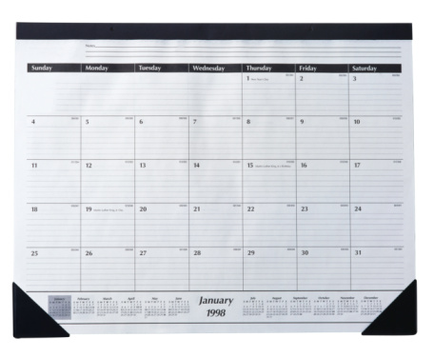
TWO WEEKS AGO

Slide 59
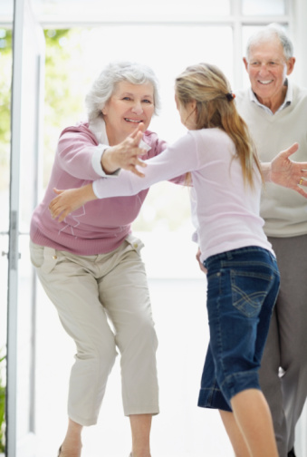
VISIT

Slide 60
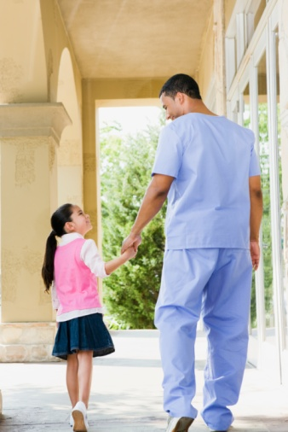
WALK

Slide 61
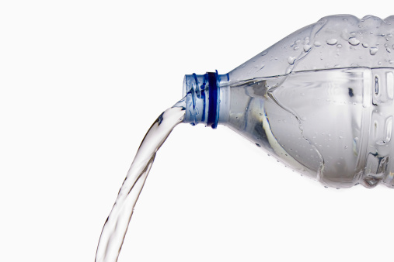
WATER

Slide 62

WHO?

Slide 63
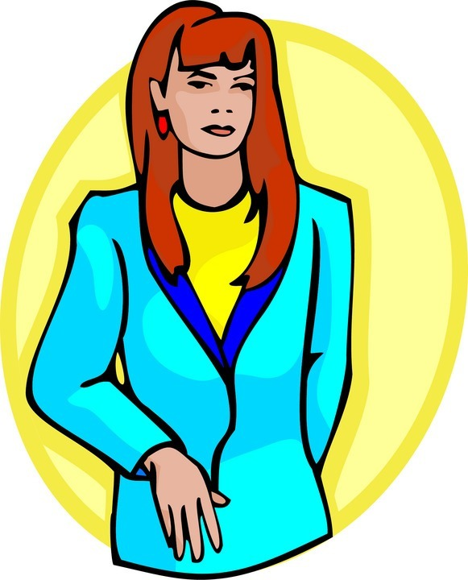
WOMAN

Slide 64
YELLOW

Slide 65
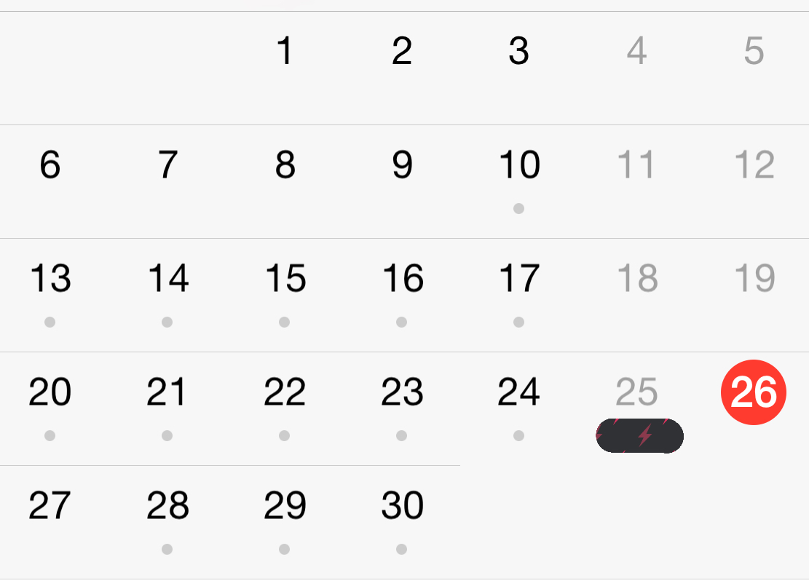
YESTERDAY

Slide 66

YOUNG

Slide 67
SATURDAY
THURSDAY
SUNDAY
TUESDAY
FRIDAY
MONDAY
WEDNESDAY

Slide 68
5, 19, 15, 2, 14,1,
7, 16, 11,
4, 18, 6,13, 17, 10, 3,
9, 20, 12, 8

Slide 69
LONDON
BIRMINGHAM
MANCHESTER
BRISTOL
NEWCASTLE
GLASGOW
CARDIFF
BELFAST

